Slide 1

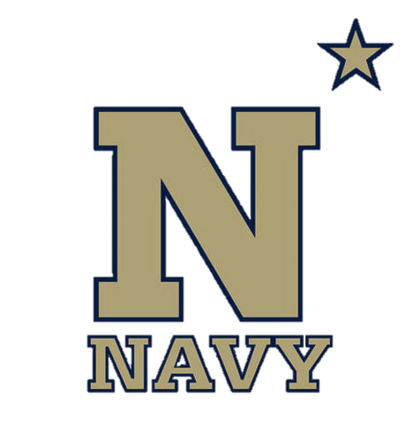
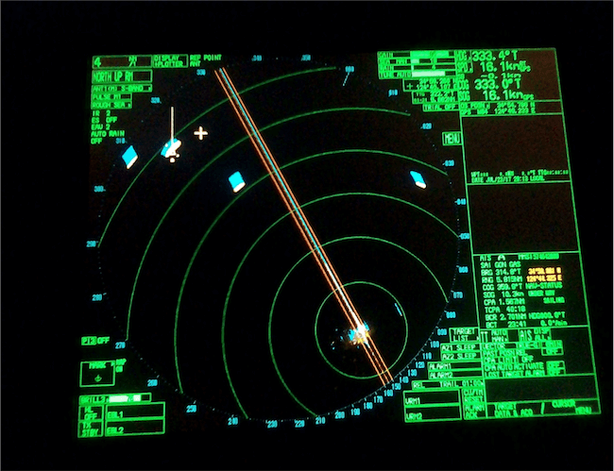
RADAR Navigation
NN220-10
SEANAV I United States Naval Academy
NN220 – Fundamentals of Navigation– Updated May 2023
Operations Officer I HMS PROTECTOR A173 I The Ice Patrol Ship

Slide 2
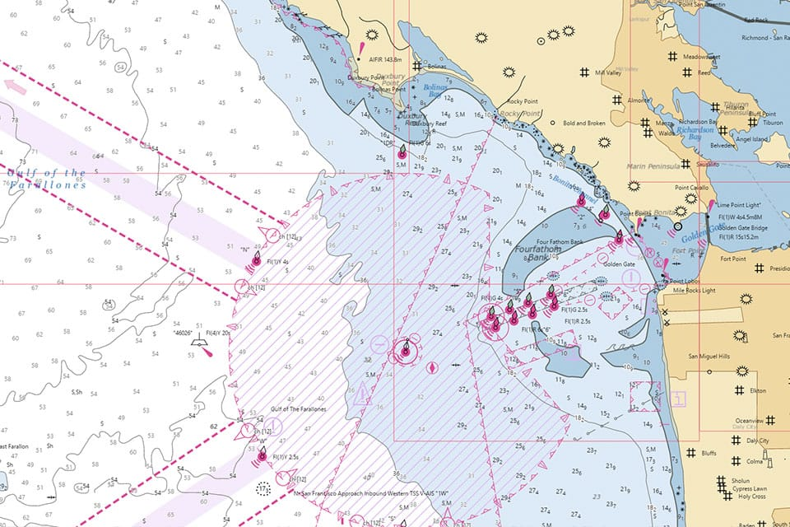
References
-The American Practical Navigator, Pub. No. 9, Bowditch, VOL. 1, 2019 Edition -Surface Ship Navigation Department Organizations and Regulations Manual (NAVDORM), COMNAVSURFPAC/COMNAVAIRPAC/COMNAVAIRLANT/COMNAVSURFLANT INSTRUCTION 3530.4 series -PUB 1310 (RADAR Navigation Manual)
SEANAV I United States Naval Academy
NN220 – Fundamentals of Navigation
Operations Officer I HMS PROTECTOR A173 I The Ice Patrol Ship

Slide 3
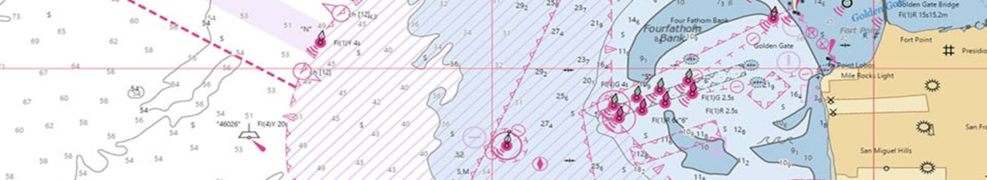
Enabling Objectives
1 – UNDERSTAND a brief history of the origin of RADAR. 2 - UNDERSTAND the components of a basic RADAR. 3 - UNDERSTAND the characteristics of RADAR transmissions. 4 - UNDERSTAND how RADAR detection can be impacted by interference. 5 - UNDERSTAND the characteristics and limitations of ARPA functionality. 6 - DESCRIBE the different aids to RADAR navigation and their application in RADAR navigation. 7 - DESCRIBE how to monitor a track using RADAR. 8 - UNDERSTAND how to fix the ship’s position by RADAR ranges and bearings. 9 - DESCRIBE an Electronic Bearing Line (EBL). 10 - DESCRIBE a Variable Range Marker (VRM). 11 - DESCRIBE how to monitor a Turn Bearing using an EBL. 12 - DESCRIBE how to monitor a Turn Range using a VRM. 13 - DESCRIBE how to use EBLs and VRMs to proceed into an anchorage. 14 - DESCRIBE how to monitor a track using Parallel Indices (PI).
SEANAV I United States Naval Academy
NN220 – Fundamentals of Navigation
Operations Officer I HMS PROTECTOR A173 I The Ice Patrol Ship

Slide 4
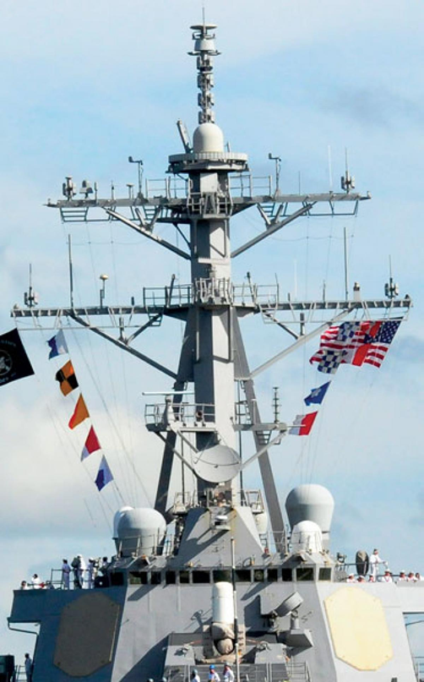
Brief History of RADAR
-Radio Detection and Ranging (RADAR) -Experimented with in the late 19th Century by Heinrich Hertz to prove that radio waves are reflected by metal objects. -Combined with a Oscilloscope in the early 20th century which allowed the pulses of energy to be timed, therefore enabling calculation of distance. -8 Nations, including the US, UK and Germany, worked in secret to develop RADAR between 1934-1939. -Great Britain was the first country to build a working system and network. Initially ground based, it was used to detect German air raids and vector RAF Fighters and was critical to victory of the Allies during the Battle of Britain. -The US coined the phrase RADAR and developed a system for use the Navy at sea.
SEANAV I United States Naval Academy
NN220 – Fundamentals of Navigation
Operations Officer I HMS PROTECTOR A173 I The Ice Patrol Ship

Slide 5
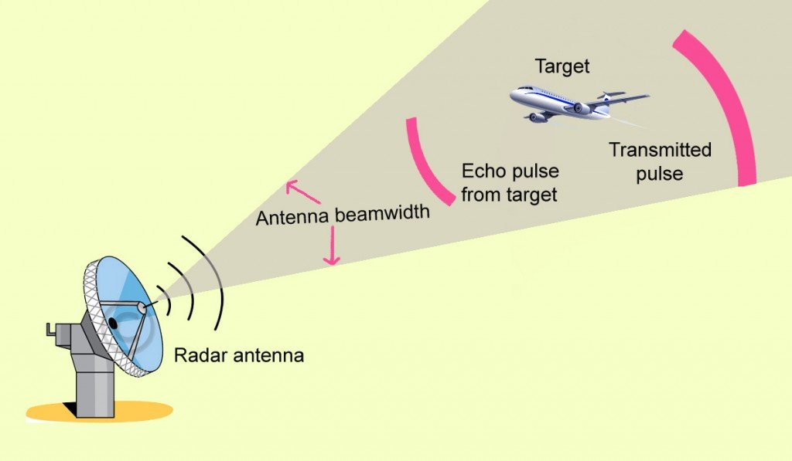
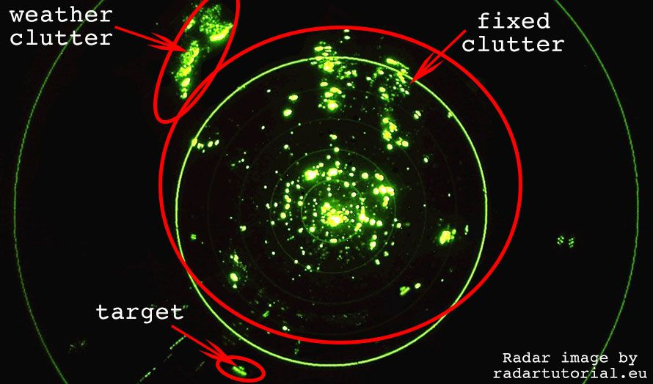
What is RADAR?
-Radar transmits Electro-Magnetic (EM) Radio Waves at a known speed. -The energy is reflected off of dense objects and materials such as metal. It is primarily used to detect aircraft, ships or land but can even get a return off of water (precipitation). -EM Waves travel at the speed of light; 186,000 miles per second. -The Time between transmission and receiving the reflected energy is recorded. -Knowing Speed and Time enables calculation of Distance.
SEANAV I United States Naval Academy
NN220 – Fundamentals of Navigation
Operations Officer I HMS PROTECTOR A173 I The Ice Patrol Ship

Slide 6
RADAR Use Today
-Most warships are equipped with multiple RADAR systems. -The IMO mandates all ships carry an operational RADAR. -RADARs are usually integrated into IBS or NAVSSI systems. -On modern ECDIS-N systems, RADAR information can be displayed. -Ideal for anti-collision and navigation.
SEANAV I United States Naval Academy
NN220 – Fundamentals of Navigation
Operations Officer I HMS PROTECTOR A173 I The Ice Patrol Ship

Slide 7
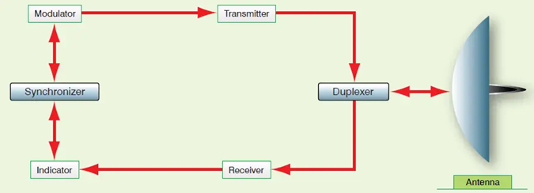
RADAR Components
A RADAR system has several critical components:
-Antenna
-Duplexer
-Transmitter
-Receiver
-Display
SEANAV I United States Naval Academy
NN220 – Fundamentals of Navigation
Operations Officer I HMS PROTECTOR A173 I The Ice Patrol Ship

Slide 8
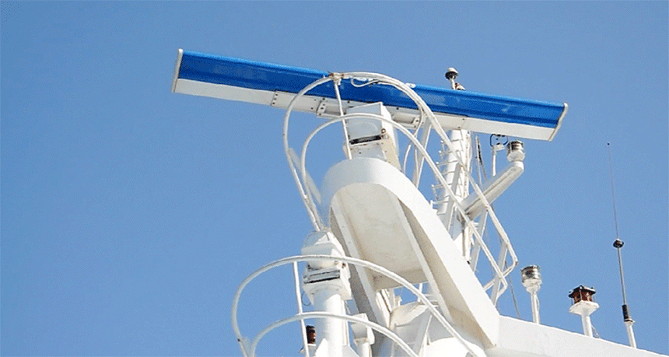
Antenna
-The Antenna is the portion of the RADAR mounted on the hull (typically the mast).
-The Antenna either transmits or receives radio waves.
-The majority of RADAR systems use a slotted waveguide antenna as it is efficient, simple and produces a beam with limited error.
SEANAV I United States Naval Academy
NN220 – Fundamentals of Navigation
Operations Officer I HMS PROTECTOR A173 I The Ice Patrol Ship

Slide 9
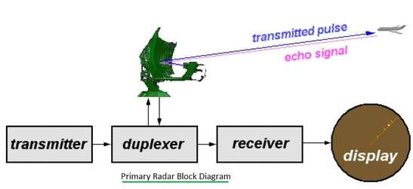
Duplexer
-The Duplexer is the electronic device of the RADAR that controls whether or not the antenna can transmit or receive radio waves.
-The antenna can only receive or transmit, it cannot do both at the same time.
-The duplexer permits the receiver and the transmitter to share an antenna!
SEANAV I United States Naval Academy
NN220 – Fundamentals of Navigation
Operations Officer I HMS PROTECTOR A173 I The Ice Patrol Ship

Slide 10
Transmitter
-The Transmitter is the electronic oscillator diode within a RADAR system that produces the radio waves that the antenna transmit.
-It cannot transmit while the RADAR is in receive mode!
SEANAV I United States Naval Academy
NN220 – Fundamentals of Navigation
Operations Officer I HMS PROTECTOR A173 I The Ice Patrol Ship

Slide 11
Receiver
-The Receiver is the electronic device within a RADAR system which receives and amplifies the weak returning signals that can then be used to present information on a display.
-It cannot receive while the RADAR is in transmit mode!
SEANAV I United States Naval Academy
NN220 – Fundamentals of Navigation
Operations Officer I HMS PROTECTOR A173 I The Ice Patrol Ship

Slide 12
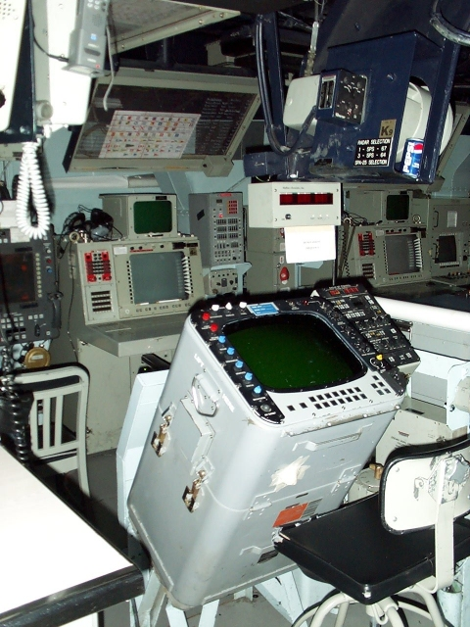
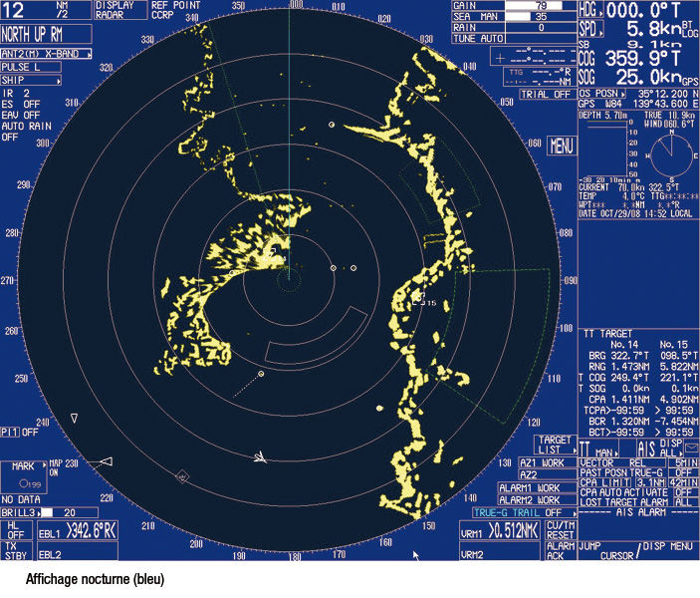
Display
-The Display is the screen which displays the information that was amplified by the receiver.
-The most common displays used on U.S. Navy ships are the SPA-25G and the ARPA.
SEANAV I United States Naval Academy
NN220 – Fundamentals of Navigation
Operations Officer I HMS PROTECTOR A173 I The Ice Patrol Ship

Slide 13
RADAR
Transmissions
-In most marine navigation applications, the RADAR signal is pulse modulated, meaning they are generated by a timing circuit.
-Radio waves leaves the antenna (via the transmitter) in very short pulses.
-As soon as the pulse leaves, the Duplexer switches the antenna to receive mode.
-Another pulse won’t be transmitted until the preceding one has had enough time to travel to the target within range and return.
-The duration or length of a single pulse is called pulse length, pulse duration, or pulse width.
SEANAV I United States Naval Academy
NN220 – Fundamentals of Navigation
Operations Officer I HMS PROTECTOR A173 I The Ice Patrol Ship

Slide 14
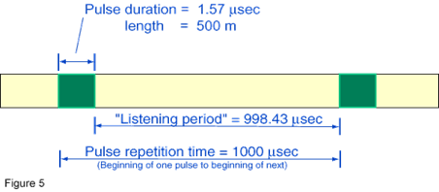
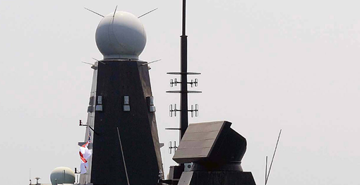
Pulse Length
-A long pulse length increases the minimum detection range based on time and distance.
-Pulse Repetition Frequency (PRF) is the number of transmissions a RADAR transmits per second.
-The shorter the pulse length, the more accurate your short range picture will be, but your range is limited as there is less time to listen.
-The longer the pulse length, the farther you can see but your short range picture will not be as accurate, as the returns from objects close to you will not be received by the antenna.
SEANAV I United States Naval Academy
NN220 – Fundamentals of Navigation
Operations Officer I HMS PROTECTOR A173 I The Ice Patrol Ship

Slide 15
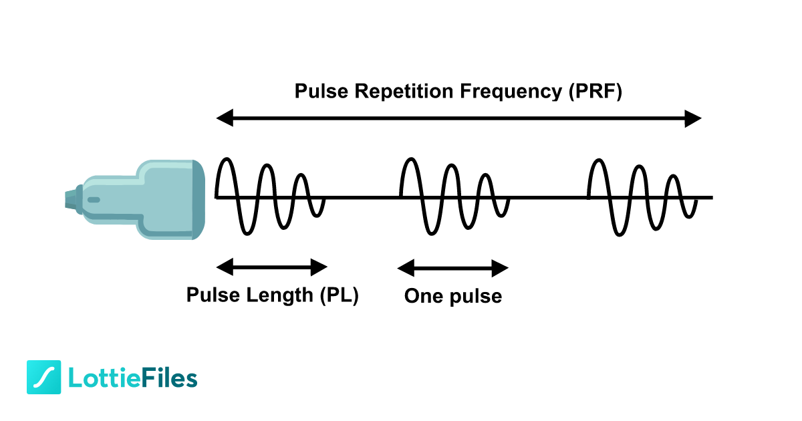
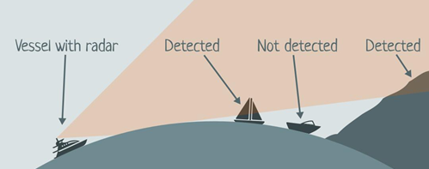
Maximum and Minimum Range
-Every RADAR has a maximum and minimum range.
-Minimum range is a factor of Pulse length. A RADAR can’t receive while transmitting.
-Maximum range is also a factor of Power, Frequency and PRF. The further a contact is from the RADAR, the more the Radio waves are scattered and attenuated, reducing the power to gain an echo.
-Curvature of the Earth also affects maximum range. This is why RADARs are placed on the mast!
-Aircraft can overcome some of the curvature limitations and can extend RADAR detection capabilities…what is typically the first aircraft off the deck during Carrier Flight Operations?
SEANAV I United States Naval Academy
NN220 – Fundamentals of Navigation
Operations Officer I HMS PROTECTOR A173 I The Ice Patrol Ship

Slide 16
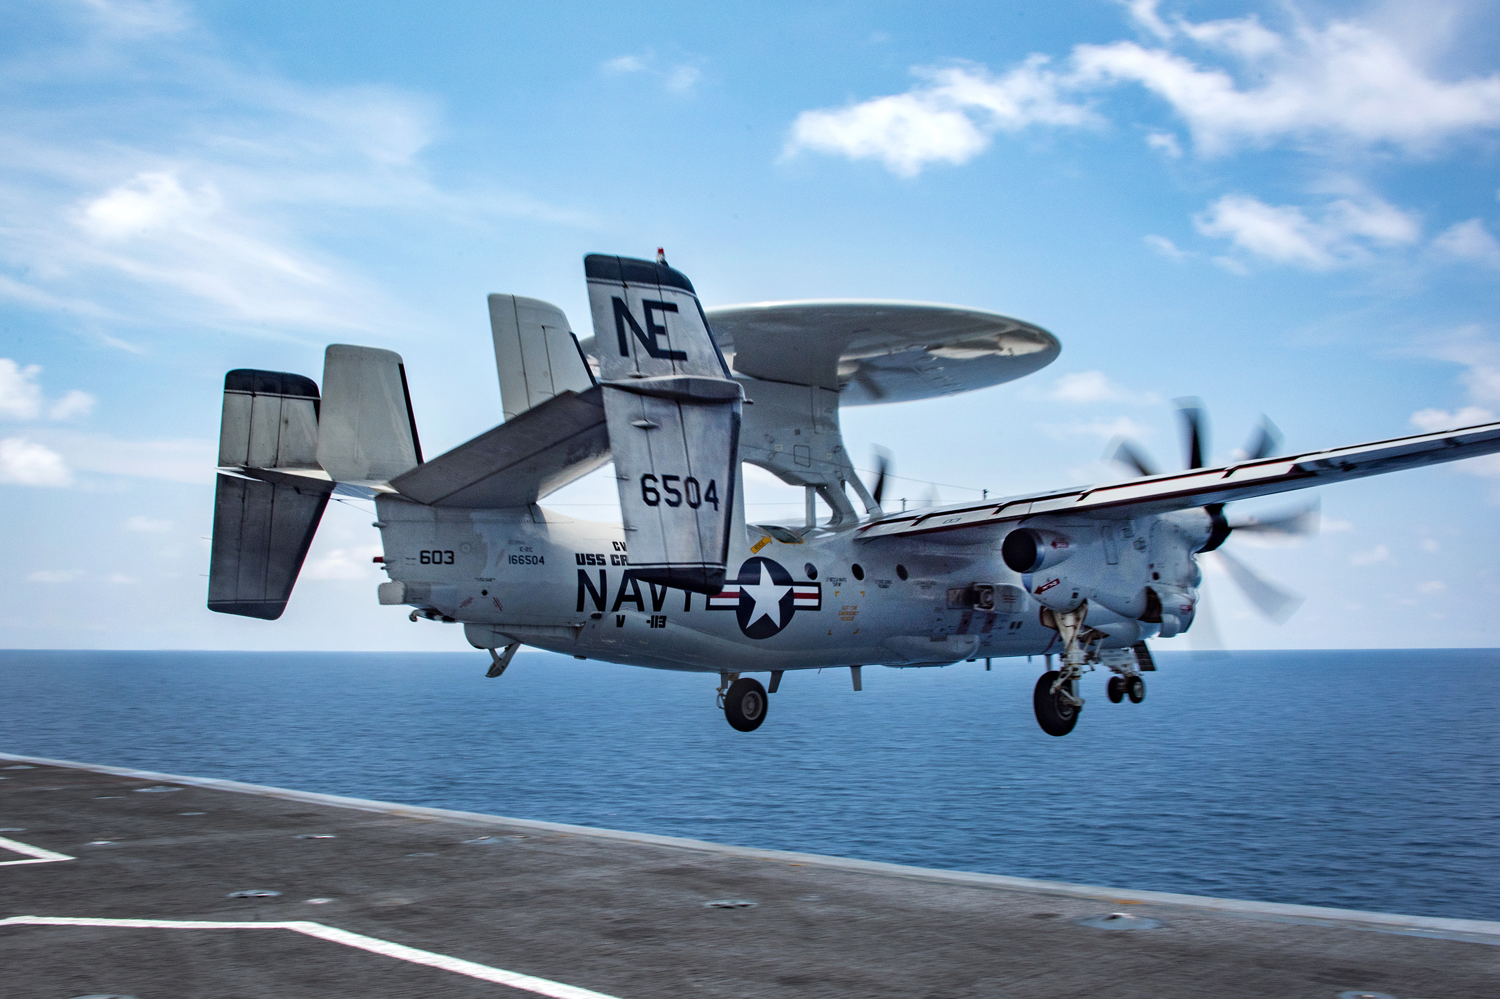
Maximum and Minimum Range
-Every RADAR has a maximum and minimum range.
-Minimum range is a factor of Pulse length. A RADAR can’t receive while transmitting.
-Maximum range is also a factor of Power, Frequency and PRF. The further a contact is from the RADAR, the more the Radio waves are scattered and attenuated, reducing the power to gain an echo.
-Curvature of the Earth also affects maximum range. This is why RADARs are placed on the mast!
-Aircraft can also extend RADAR detection capabilities…what is typically the first aircraft off the deck during Carrier Flight Operations?
SEANAV I United States Naval Academy
NN220 – Fundamentals of Navigation
Operations Officer I HMS PROTECTOR A173 I The Ice Patrol Ship

Slide 17
Maximum and Minimum Range
-Warships combat maximum and minimum range by having multiple RADAR systems capable of long and medium range capabilities.
-Newest systems are Multi-Function RADAR (MFR) which means the beam can be steered and adjusted to change the characteristics of the RADAR!
LONG RANGE!
MEDIUM RANGE!
SEANAV I United States Naval Academy
NN220 – Fundamentals of Navigation
Operations Officer I HMS PROTECTOR A173 I The Ice Patrol Ship

Slide 18
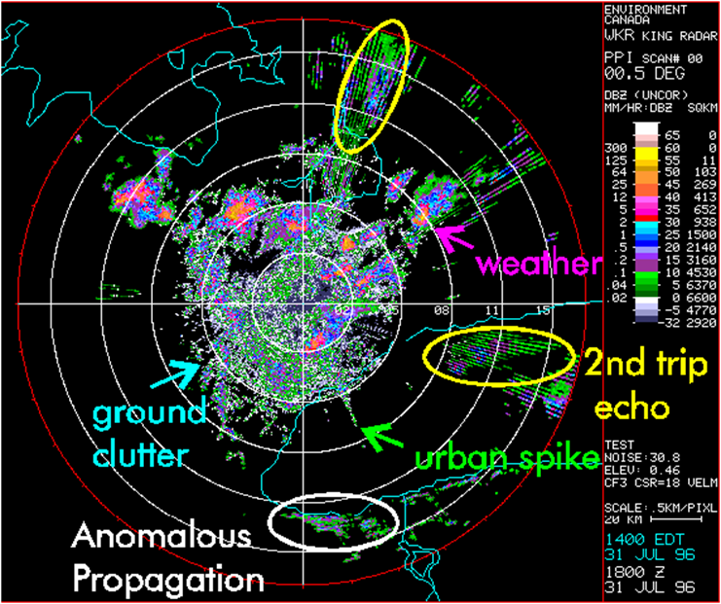
RADAR Interference
-RADAR transmissions reflect off dense materials and objects, even those that we do not want it to!
-Atmospheric conditions, such as Rain, Fog, Snow and Sleet, affect the performance of RADAR detection.
-Some RADARs, such as weather RADARs, want to detect and track precipitation.
-For navigation RADARs, this can be problematic.
-We can tune our RADAR to maximize the detection of vessels, land and hazards while tuning out clutter associated with precipitation and sea state.
SEANAV I United States Naval Academy
NN220 – Fundamentals of Navigation
Operations Officer I HMS PROTECTOR A173 I The Ice Patrol Ship

Slide 19
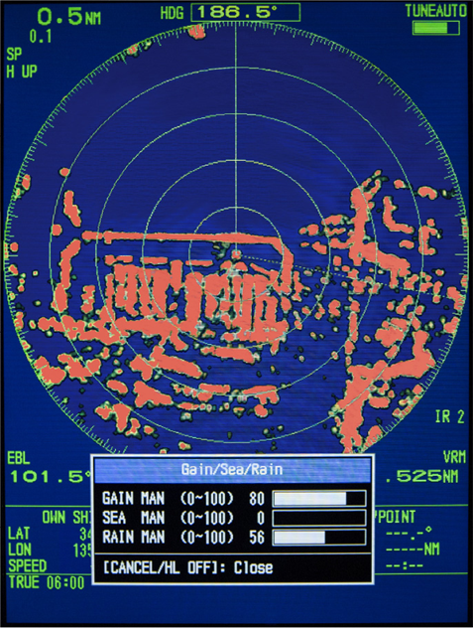
Gain, Rain and Sea
-There are three main control settings to minimize clutter:
Gain
Rain
Sea
SEANAV I United States Naval Academy
NN220 – Fundamentals of Navigation
Operations Officer I HMS PROTECTOR A173 I The Ice Patrol Ship

Slide 20
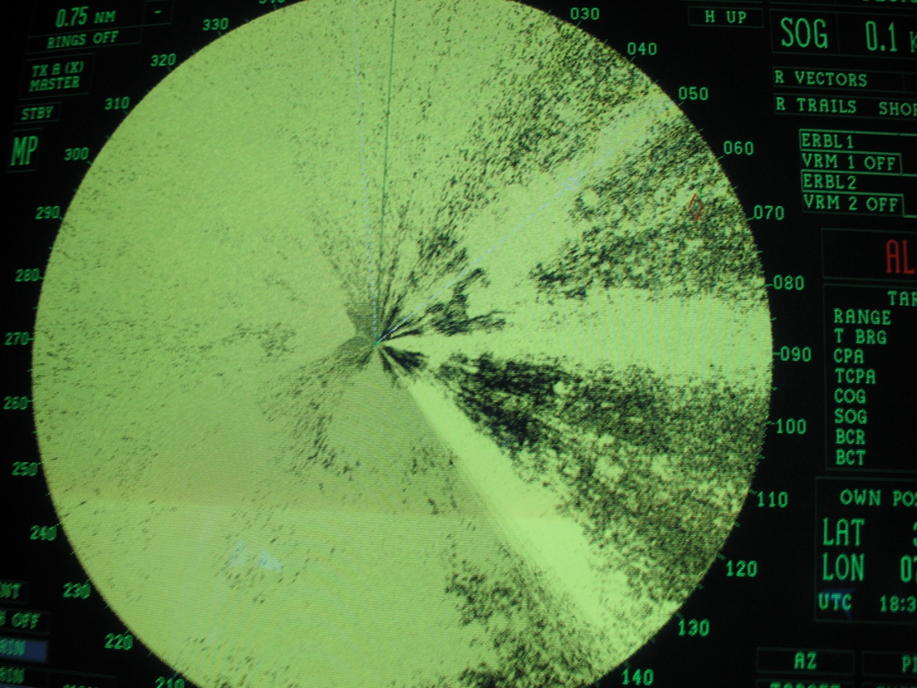
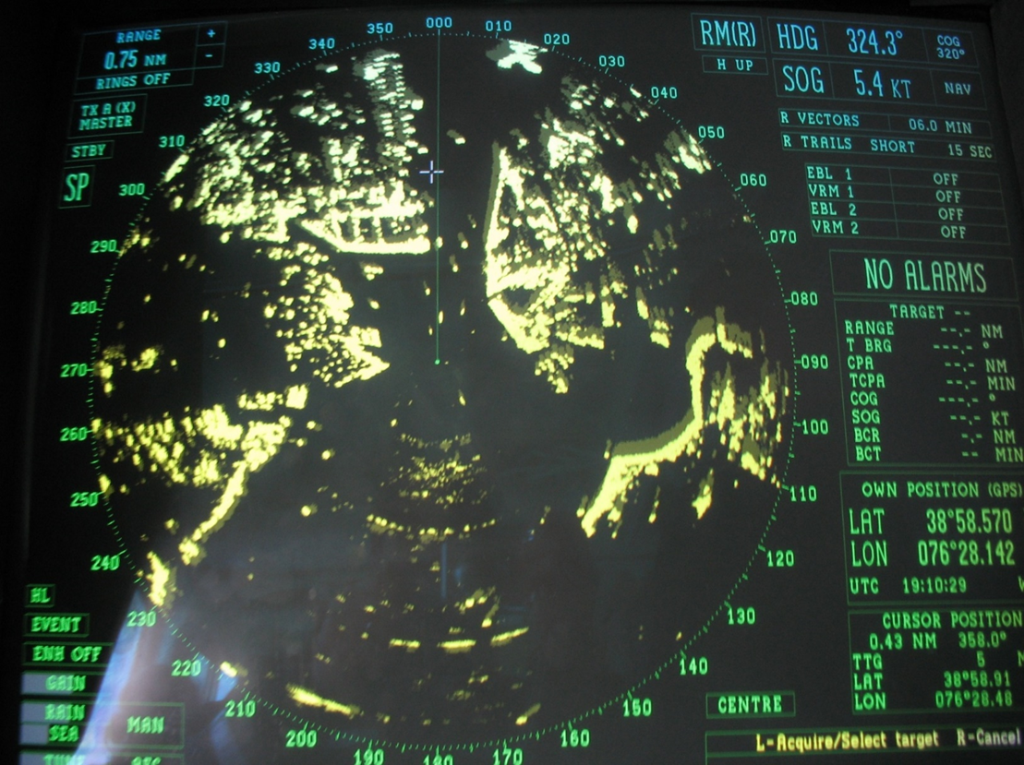
Gain
-Gain manages the amplification of the return.
-In some cases, the return from a contact can be so powerful that it prevents the return from other objects from being seen on the display.
-Adjust gain to reduce the amplification of your return and allow your RADAR to display all returns efficiently.
SEANAV I United States Naval Academy
NN220 – Fundamentals of Navigation
Operations Officer I HMS PROTECTOR A173 I The Ice Patrol Ship

Slide 21
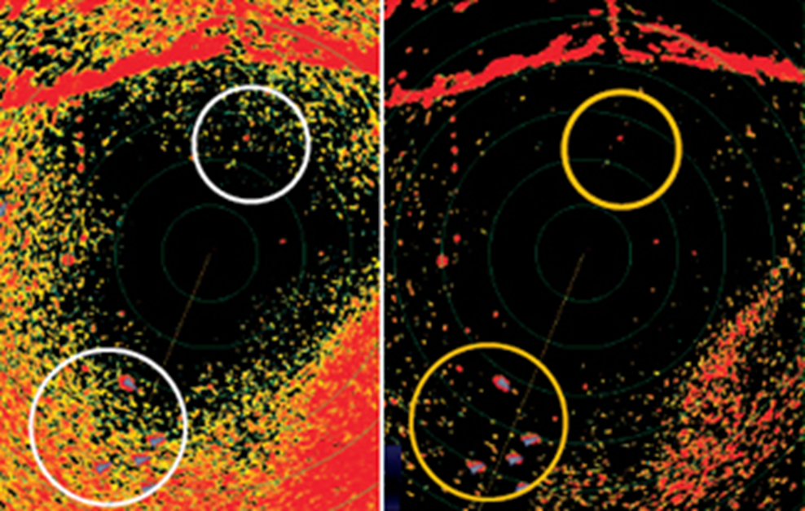
Rain
-The Rain setting reduces the sensitivity of the RADAR return so that more dense objects, such as ships or aids to navigation, are detected rather than heavy weather or precipitation.
SEANAV I United States Naval Academy
NN220 – Fundamentals of Navigation
Operations Officer I HMS PROTECTOR A173 I The Ice Patrol Ship

Slide 22
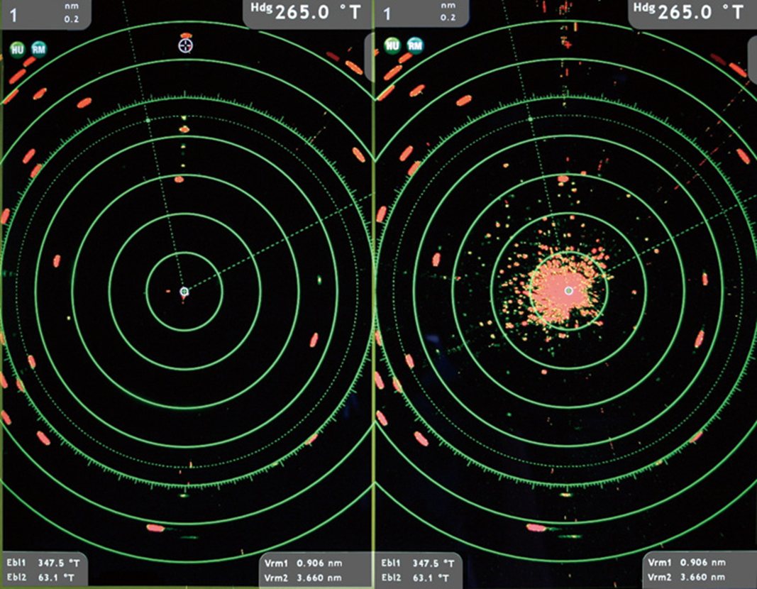
Sea
-The Rain setting reduces the sensitivity of the RADAR return to remover clutter caused by the sea state.
SEANAV I United States Naval Academy
NN220 – Fundamentals of Navigation
Operations Officer I HMS PROTECTOR A173 I The Ice Patrol Ship

Slide 23
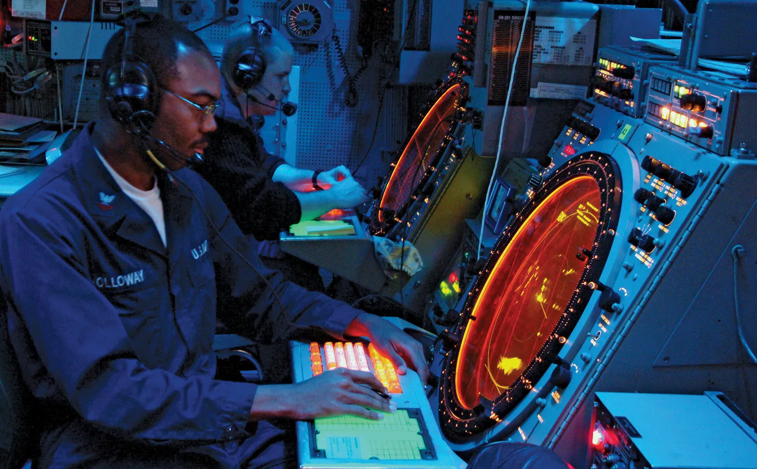
Gain, Rain and Sea
-There is a trade-off.
-Adjusting the Gain, Rain and Sea setting will effectively dim your RADAR.
-Many objects that would have been detected may not be after you adjust these settings.
-Always ensure you adjust your RADAR to the degree necessary for safe navigation.
-Always maintain a lookout by sight and hearing…do not blindly trust RADAR!
SEANAV I United States Naval Academy
NN220 – Fundamentals of Navigation
Operations Officer I HMS PROTECTOR A173 I The Ice Patrol Ship

Slide 24
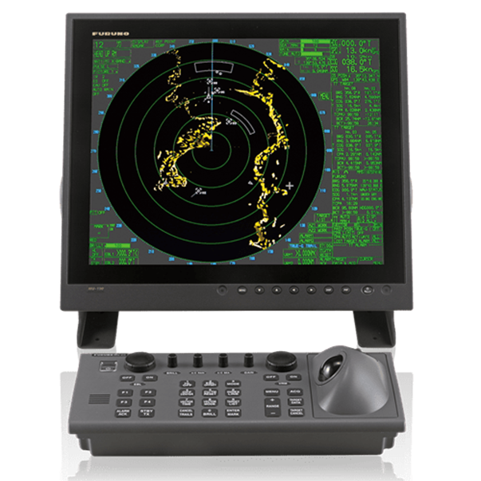
Automated RADAR Plotting Aid (ARPA)
-Modern RADAR displays are PC based and use software to track contacts.
-This software is called Automated RADAR Plotting Aid (ARPA).
-ARPA integrates information from GPS, Gyrocompasses, and Speed Logs to calculate a contact’s course, speed, and Closest Point of Approach information such as bearing, time and range. (MOBOARDS!)
-Most ARPA systems require at least 30 seconds to build useable contact information. 120-180 seconds will provide reliable information.
-ARPA can integrate to ECDIS.
SEANAV I United States Naval Academy
NN220 – Fundamentals of Navigation
Operations Officer I HMS PROTECTOR A173 I The Ice Patrol Ship

Slide 25
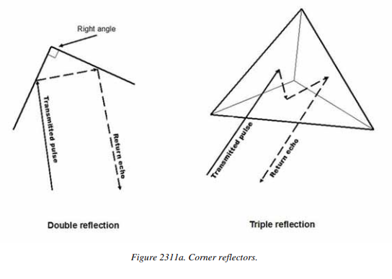
Aids to RADAR Navigation
-RADAR navigation aids help identify RADAR targets and increase echo signal strength from otherwise poor RADAR targets.
-Buoys are poor RADAR targets, if not properly equipped.
-Some buoys will have RADAR reflectors, mounted usually on the top or designed into the structure.
SEANAV I United States Naval Academy
NN220 – Fundamentals of Navigation
Operations Officer I HMS PROTECTOR A173 I The Ice Patrol Ship

Slide 26
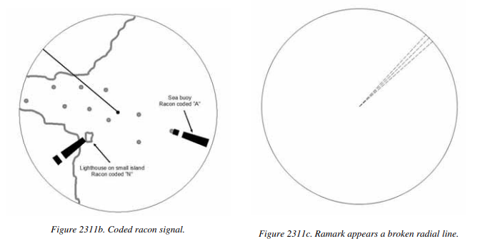
Aids to RADAR Navigation
-RADAR reflectors may help, but typically other means must be used.
-RADAR Beacons are transmitters operating in the marine RADAR frequency band.
-Produces distinctive indications on the RADAR displays of ships within range of these beacons.
-RADAR beacons are broken up into two categories: RACONs and RAMARKs.
SEANAV I United States Naval Academy
NN220 – Fundamentals of Navigation
Operations Officer I HMS PROTECTOR A173 I The Ice Patrol Ship

Slide 27
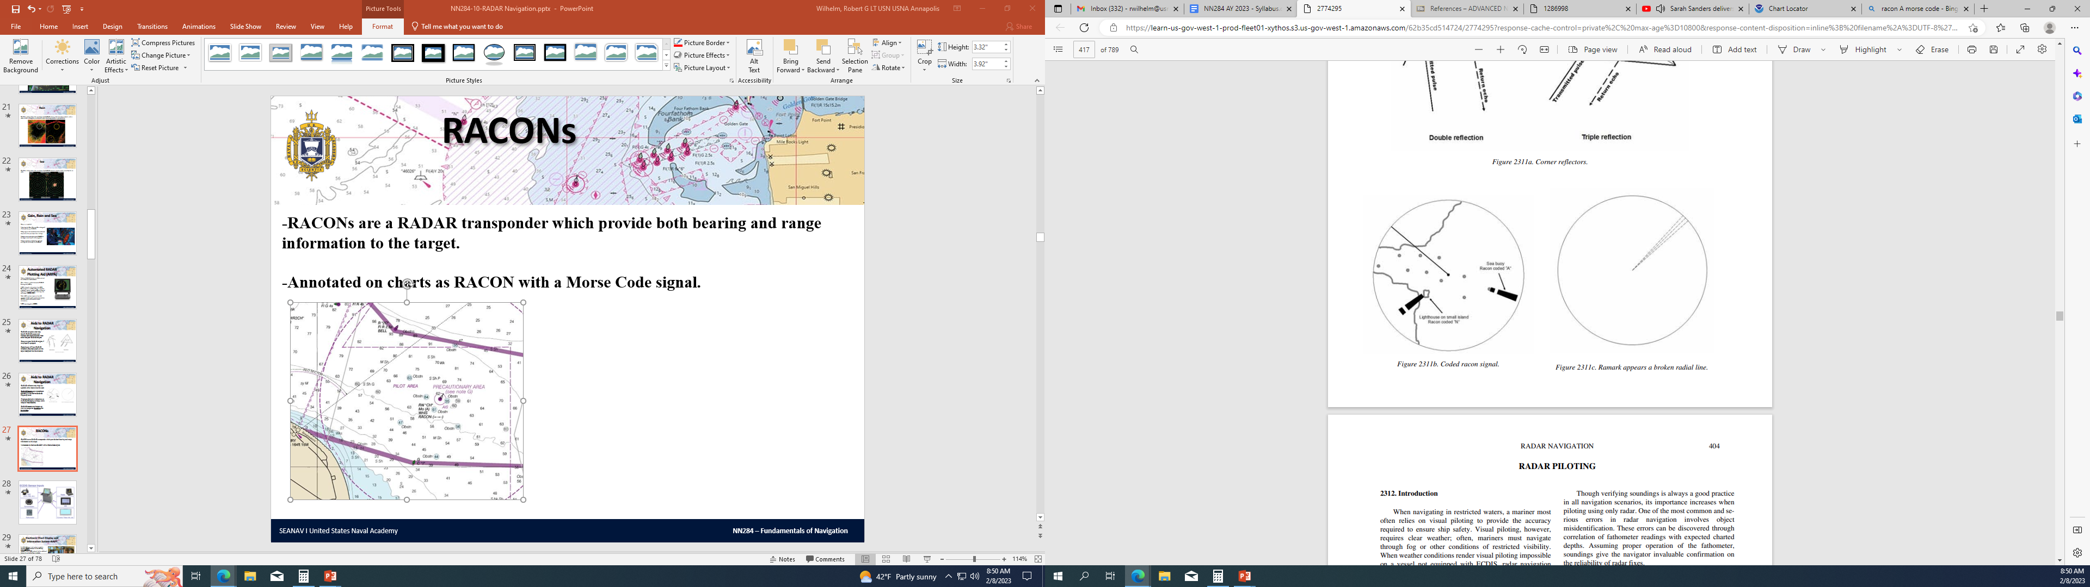
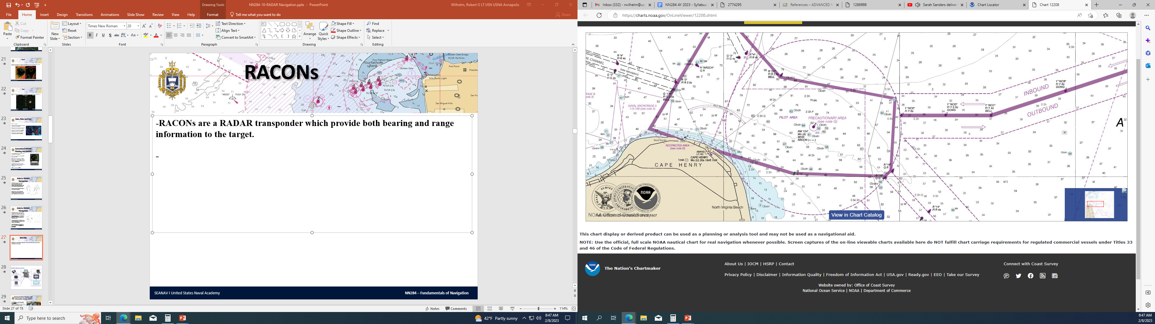
RACONs
-RACONs are a RADAR transponder which provide both bearing and range information to the target.
-Annotated on charts as RACON with a Morse Code signal.
SEANAV I United States Naval Academy
NN220 – Fundamentals of Navigation
Operations Officer I HMS PROTECTOR A173 I The Ice Patrol Ship

Slide 28
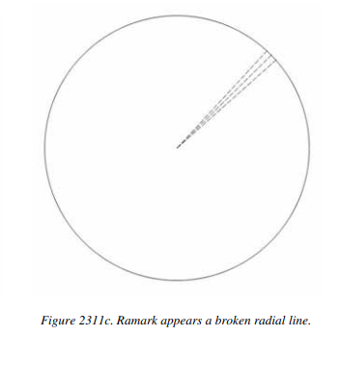
RAMARKs
-RAMARKs are a RADAR transponder which provide bearing information only.
-Not as useful as RACONs.
-Not widely used anymore.
SEANAV I United States Naval Academy
NN220 – Fundamentals of Navigation
Operations Officer I HMS PROTECTOR A173 I The Ice Patrol Ship

Slide 29
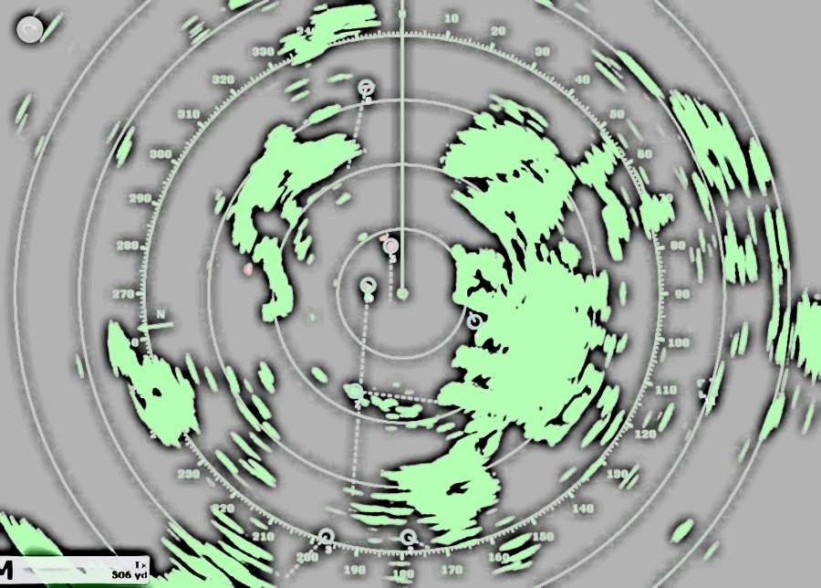
RADAR Navigation
-When navigating in restricted waters, a navigator most often relies on visual aids to navigation.
-Visual navigation requires clear weather. We still navigate in restricted visibility, so what is the alternative?
-RADAR navigation provides a method of fixing the ship’s position with sufficient accuracy to allow safe passage.
-Even with ECDIS, RADAR navigation provides a vital positional cross-checking capability that is necessary to the practice of safe and prudent navigation.
SEANAV I United States Naval Academy
NN220 – Fundamentals of Navigation
Operations Officer I HMS PROTECTOR A173 I The Ice Patrol Ship

Slide 30
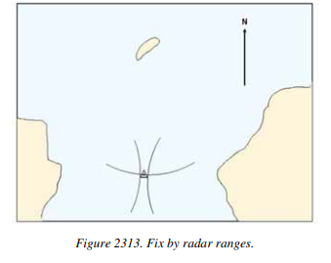
Fixes by RADAR Ranges
Most accurate RADAR fixes come from measuring and plotting ranges from three or more objects.
Prioritize objects on the Bow and Stern first, then on the Beam.
Objects ideally should be separated by 60°-90°.
Object misidentification is a common error with RADAR.
Use the fathometer to correlate your RADAR fixes!
SEANAV I United States Naval Academy
NN220 – Fundamentals of Navigation
Operations Officer I HMS PROTECTOR A173 I The Ice Patrol Ship

Slide 31
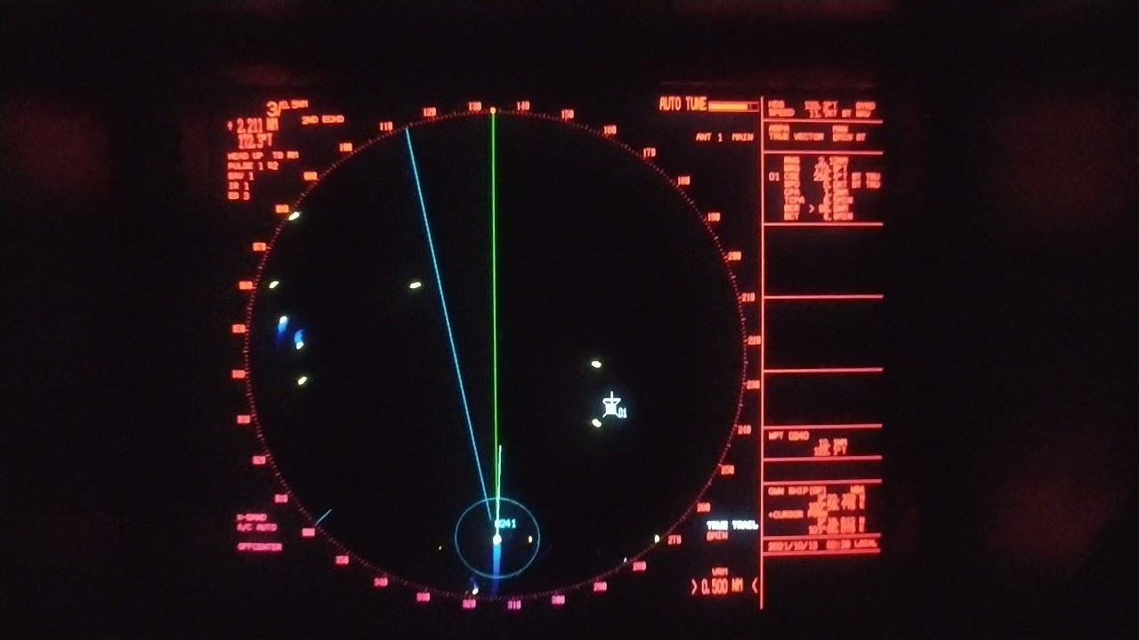
Fixes by RADAR Bearings
When determining a fix by RADAR bearings, prioritize Beam, Bow and then Stern.
Prioritize objects that can be correlated on the charts and on RADAR…Beacons equipped with RADAR reflectors are ideal!
Can be used to plot a position quickly when approaching restricted waters.
This method is not ideal for accuracy. Use only when no more accurate method is available.
SEANAV I United States Naval Academy
NN220 – Fundamentals of Navigation
Operations Officer I HMS PROTECTOR A173 I The Ice Patrol Ship

Slide 32
Electronic Bearing Line (EBL)
The Trail or track history grows over time; normally 6 mins to enable math calculation
An Electronic Bearing Line (EBL) is a line we can plot from the center of the RADAR (own ship) and can immediately find the bearing to another object on the screen.
The EBL can be off-set and moved around the screen so that the direction of relative motion can be measured.
000
045
Contact Bears 045 True from us.
The Trail indicates direction of relative movement.
060
A RADAR Trail enables monitoring of the relative movement of a detected contact in relation to your own Ship over a period of time. Can be beneficial for Contact Management.
This information can assist with MOBOARDs to calculate the contact’s True Course and even Speed.
Off-set EBL 176
The contact’s bearing is now 060 True. Its bearing movement is right.
270
090
Electronic Bearing Line (EBL) – used to measure the True bearing or movement of a detected object.
SEANAV I United States Naval Academy
NN310 - Advanced Navigation (NAV_2)
Operations Officer I HMS PROTECTOR A173 I The Ice Patrol Ship

Slide 33
Contact Management by RADAR –
Which contact concerns you?
Use the EBL to determine CBDR and risk of collision on a contact
-Place an EBL on the contact.
-If the contract tracks down the EBL, CBDR and a risk of collision exists

Slide 34
Variable Range Marker (VRM)
-The Variable Range Marker (VRM) can be adjusted to assess range from our Ship. This can be from the point of detection or to calculate CPA.
- For Range on Detection, the Variable Range Marker (VRM) is measured from the Ship. The distance is therefore relative to us.
-Using the EBL placed along the RADAR Trail to get Relative Direction of Motion, we can combine this with the VRM to calculate the CPA in the future.
000
Contact Bears 045 True from us. It’s initial range on detection is 2nm using the VRM.
By aligning the VRM to the tangent of the off-set EBL, the CPA can be calculated.
045
2.0nm
1.5nm
060
The contact’s bearing is now 060 True. It’s range has decreased to 1.5nm
1.0nm
The True bearing of CPA is 090.
0.5nm
The distance of CPA is 1.25nm.
090
270
1.25nm
Variable Range Marker (VRM) – used to measure the Distance of a detected object from us.
SEANAV I United States Naval Academy
NN310 - Advanced Navigation (NAV_2)
Operations Officer I HMS PROTECTOR A173 I The Ice Patrol Ship

Slide 35
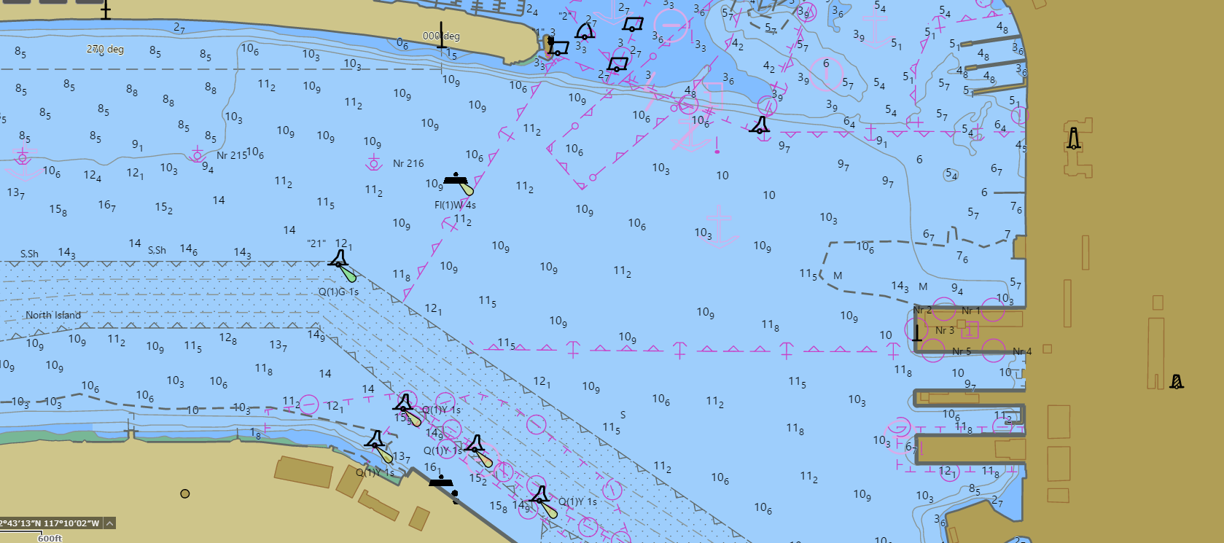
Monitoring Track by Head Bearing
We can use functions such as the Electronic Bearing Line (EBL) and Variable Range Marker (VRM) to monitor and assess track.
When transiting into or from a Port, track legs are normally aligned to a Head or Stern Mark so that a visual assessment of position can be made.
We can use the EBL on the RADAR to monitor our track based on the Head Bearing, provided the object is RADAR conspicuous, or easily identifiable.
SEANAV I United States Naval Academy
NN310 - Advanced Navigation (NAV_2)
Operations Officer I HMS PROTECTOR A173 I The Ice Patrol Ship

Slide 36
Monitoring Turns by Turn Bearing
Multiple EBLs can be used concurrently to monitor not only a Head Bearing, but also Turn Bearings so support the Navigation Team, especially in Restricted Visibility.
Once the EBL touches the conspicuous mark, you are at the Turn point.
To accurately navigate, a Ship’s Advance and Transfer must be plotted to take into account movement of the Ship in a turn. The Turn Point position is then calculated back from where the track legs intersect.
Ship uses Head Bearing to monitor track.
The distance to the Turn is counted down and monitored visually using a Turn Bearing. That is, the True Bearing to a known object at the point of Wheeling Over. Provided the object is RADAR conspicuous, a Turn Bearing can be similarly monitored on RADAR using an EBL. Accuracy however is dependent on the Gyro information feeding into the RADAR.
SEANAV I United States Naval Academy
NN310 - Advanced Navigation (NAV_2)
Operations Officer I HMS PROTECTOR A173 I The Ice Patrol Ship

Slide 37
Monitoring Turns by Turn Ranges
The Turn Point can also be monitored using Distance. A Turn Range is measured between a conspicuous object and the Turn Point and then monitored using a VRM.
The VRM range is set to 1250yds relative to the Ship.
A Turn Bearing can also be marked by a Turn Range. That is, the Range from a conspicuous object monitored on Radar by using the VRM.
The VRM range is set to 1250yds relative to the Ship.
Distance from TB to conspicuous mark is calculated at 1250yds.
When the VRM touches the object, you are at the Turn Point.
The distance between the Turn Point and a conspicuous object is measured and the VRM is then set to that distance.
SEANAV I United States Naval Academy
NN310 - Advanced Navigation (NAV_2)
Operations Officer I HMS PROTECTOR A173 I The Ice Patrol Ship

Slide 38
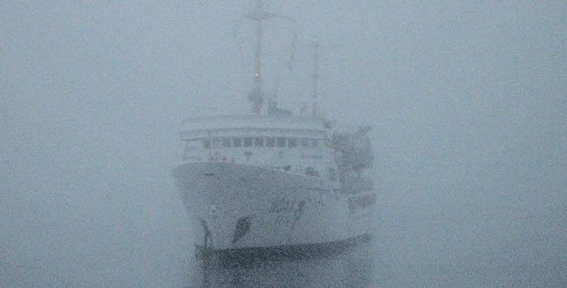
Anchoring by RADAR
We have discussed how to use a head bearing to stay on track and how to use turn bearings and turn ranges to mark a turn.
These same fundamentals can be applied to anchoring!
This is especially helpful during restricted visibility.
SEANAV I United States Naval Academy
NN220 – Fundamentals of Navigation
Operations Officer I HMS PROTECTOR A173 I The Ice Patrol Ship

Slide 39
These tools can be used for navigating a Ship to Anchor using Radar; for instance when in Restricted Visibility.
A Head Bearing is used in conjunction with a Drop Bearing and Drop Range.
Anchor Position or Turn Bearing is marked

Slide 40
Parallel Indices
Parallel Indices (PI) are lines that are plotted on a chart or a RADAR that are parallel to the prescribed track line at a fixed distance.
The index is typically set on a conspicuous object(s), preferably identifiable on RADAR.
This technique is an effective way to monitor a vessels progress along a preselected track using a RADAR.
Most ARPA systems have a dedicated PI function. We can also use unfixed EBLs as well.
SEANAV I United States Naval Academy
NN220 – Fundamentals of Navigation
Operations Officer I HMS PROTECTOR A173 I The Ice Patrol Ship

Slide 41
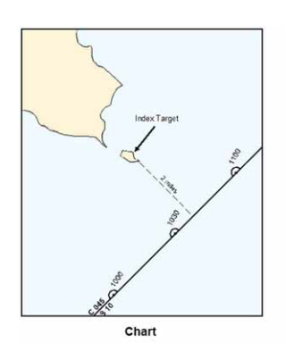
Parallel Indices
Imagine that we want to follow a track line that leaves a small island or rock to port at a distance of 2 miles off when abeam.
The track line is 045° T.
SEANAV I United States Naval Academy
NN220 – Fundamentals of Navigation
Operations Officer I HMS PROTECTOR A173 I The Ice Patrol Ship

Slide 42
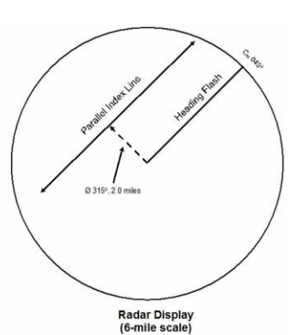
Parallel Indices
We will place an electronic line (Parallel Index) on the RADAR screen bearing 045°T - 225°T at a range of 2nm.
The line will be parallel to our track.
All we need to do is keep the island on the Parallel Index line we have created.
This will help keep us on track.
SEANAV I United States Naval Academy
NN220 – Fundamentals of Navigation
Operations Officer I HMS PROTECTOR A173 I The Ice Patrol Ship

Slide 43
Parallel Indices
Ideally, we will want to find two conspicuous objects on which to place our PI lines on.
The following example highlights a preferred PI as we head into port.
SEANAV I United States Naval Academy
NN220 – Fundamentals of Navigation
Operations Officer I HMS PROTECTOR A173 I The Ice Patrol Ship

Slide 44
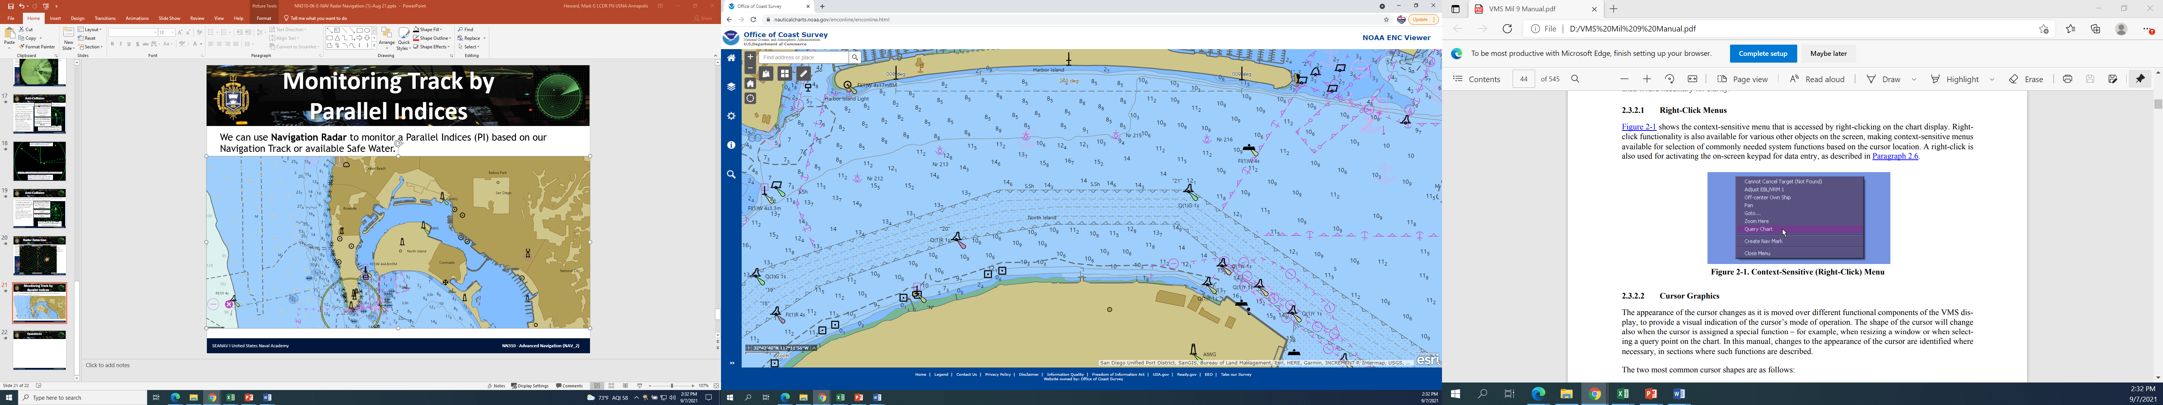
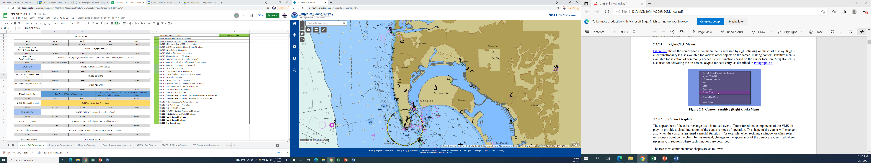
Monitoring Track by Parallel Indices
We can use Navigation Radar to monitor a Parallel Indices (PI) based on our Navigation Track or available Safe Water.
This Navigation Track goes through the restricted waters of San Diego Harbor. The Navigator has identified conspicuous radar marks in advance.
Our course for this leg is 090 True. We draw a parallel line to navigation track from the conspicuous radar mark.
Using the VRM on VMS, measure the distance between the parallel line and track.
The Sea setting reduces sensitivity to remove Clutter caused by Sea State.
In this case, the distance is 850yds.
SEANAV I United States Naval Academy
NN310 - Advanced Navigation (NAV_2)
Operations Officer I HMS PROTECTOR A173 I The Ice Patrol Ship

Slide 45
PI: 850 yds
On Radar, the PI line is drawn offset from the Ship by 850yds on the same True bearing as the Leg.
If the PI is left of the conspicuous mark, the Ship must be to the left of track.
We can adjust our Ship’s course to regain.
After altering course Right, when the PI line touches the conspicuous radar mark, we must have regained track.
The distance between the mark and the PI can be measured on the radar using a VRM in order to calculate the distance off track.
In this case, we are 40yrds left of track.

Slide 46
Enabling Objectives
1 – UNDERSTAND a brief history of the origin of RADAR. 2 - UNDERSTAND the components of a basic RADAR. 3 - UNDERSTAND the characteristics of RADAR transmissions. 4 - UNDERSTAND how RADAR detection can be impacted by interference. 5 - UNDERSTAND the characteristics and limitations of ARPA functionality. 6 - DESCRIBE the different aids to RADAR navigation and their application in RADAR navigation. 7 - DESCRIBE how to monitor a track using RADAR. 8 - UNDERSTAND how to fix the ship’s position by RADAR ranges and bearings. 9 - DESCRIBE an Electronic Bearing Line (EBL). 10 - DESCRIBE a Variable Range Marker (VRM). 11 - DESCRIBE how to monitor a Turn Bearing using an EBL. 12 - DESCRIBE how to monitor a Turn Range using a VRM. 13 - DESCRIBE how to use EBLs and VRMs to proceed into an anchorage. 14 - DESCRIBE how to monitor a track using Parallel Indices (PI).
SEANAV I United States Naval Academy
NN220 – Fundamentals of Navigation
Operations Officer I HMS PROTECTOR A173 I The Ice Patrol Ship

Slide 47
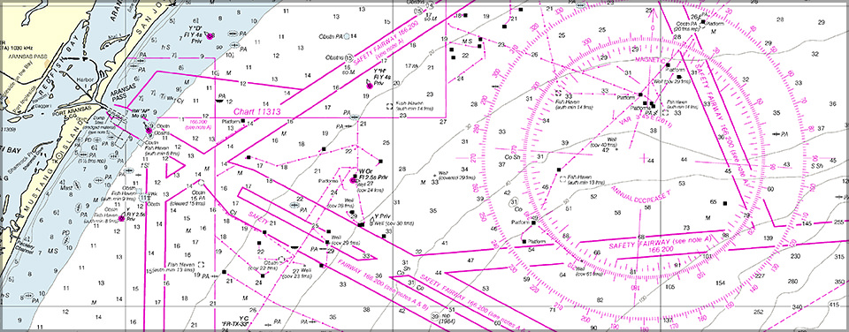
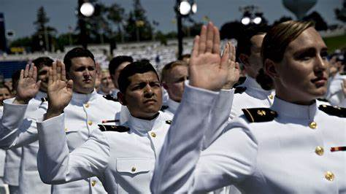
Questions?
SEANAV I United States Naval Academy
NN220 – Fundamentals of Navigation
Operations Officer I HMS PROTECTOR A173 I The Ice Patrol Ship

